Slide 1

DO NOW: This picture was used to advertise a product. Based on the picture what product was being advertised?
The French clothing retailer
La Redoute used this ad for full day before anyone noticed the problem. Did you notice?

Slide 2
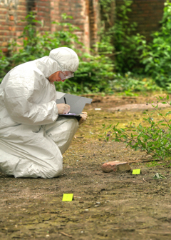
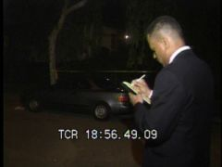
AIM: How well do we observe?
One of the most important tools of the forensic investigator is the ability to observe, interpret and report observations clearly, whether at a crime scene or in the lab.
Which evidence is considered good evidence to collect?

Slide 3
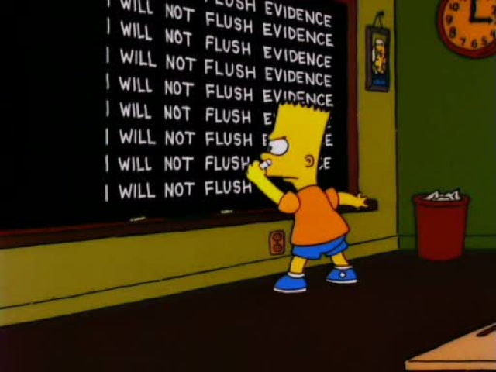
Making accurate observations can be difficult because there is so much information stimulating our senses, our brains apply an unconscious filter.
We pay more attention to what is important at that moment and paying attention to details requires a conscious effort.

Slide 4
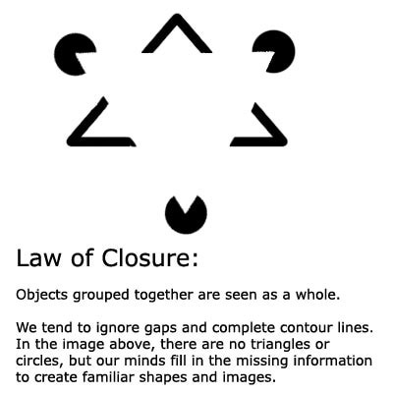
For example our brains will fill in missing information, that is not really there.

Slide 5

Our brains will also apply prior knowledge to new situations.
What flavor is this ice cream?

Slide 6
Work Period:
Attacked Poodle
  Students are to work individually
  Students are to read the opener and the hints given to figure out which dog attacked the poodle…or better yet, which dog did not attack the poodle.
  On the back of the poodle WS (which is blank), complete a CER Model (Claim, Evidence, Reasoning) using your paper to help.

